Slide 1
Bray Team Week 8/9 Update
Avery Haynes, Locke Lehmann, Travis Carlson, Cody Sims, Zachary Walker, Michael Hager
10/11/2023

Slide 2
Problem Statement Summary
Develop a method to internally measure valve position independent of an actuator, measure actuator output torque, and detect fluid leakage to increase the valve's service life.
Priorities: position and torque
Bray cares about all three, customers care about torque and leakage
Existing solution: IOT Torque Bracket

Slide 3
Week 8 deliverables
Week 8 Tasks
Deliverable | Team Member | Percent Completed | Notes
Discuss concept generations with Bray | All | 30% | Team meeting on Friday
Receive and look at final SolidWorks model | Zack | 0% | Need to get it from Bray
Schedule final presentation date | All | 50% | Discuss with Dr. Chen and Bray team
Continue WBS and Gantt chart for 401/402 | Michael | 35%
Continue using concept methodologies | Avery/Locke | 75% | Need to further discuss ideas in this ppt

Slide 4
Week 9 Plans
Week 9 Tasks
Deliverable | Team Member | Percent Completed | Notes
Analyze the results of Brays concept review | All | 0% | Get feedback midweek
Receive and look at final SolidWorks model | Zack | 0% | Need to get it from Bray
Schedule final presentation date | Zack | 0% | Only 1 person at friday meeting so need to email to get final date
Continue WBS and Gantt chart for 401/402 | Michael | 35% | Started but need to bring up to quality for DR2 report
Begin draft of DR2 report covering the concept generation aspects | Avery/Locke | 0% | Still need some work done for the concept selection but will focus on writing what we can
IIAE Concept selection Matrix | Cody/Travis | 0% | Complete so results from the pugh chart can be compared

Slide 5
Concept Generation 1
Brainstorming/Mind-Mapping
Idea generation session where ideas were linked graphically to the central problem - photos on the next two slides for the two most important issues (position and torque), since they are separate problems

Slide 6
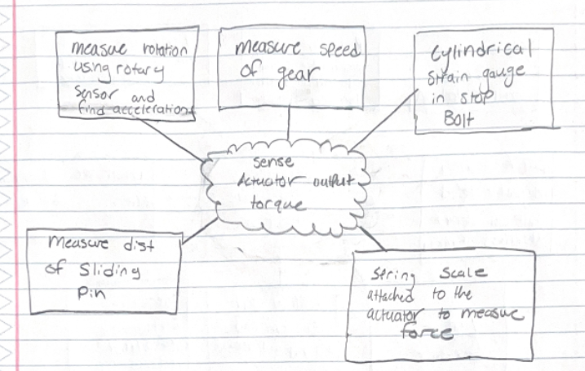
Concept Generation 1
Torque problem

Slide 7
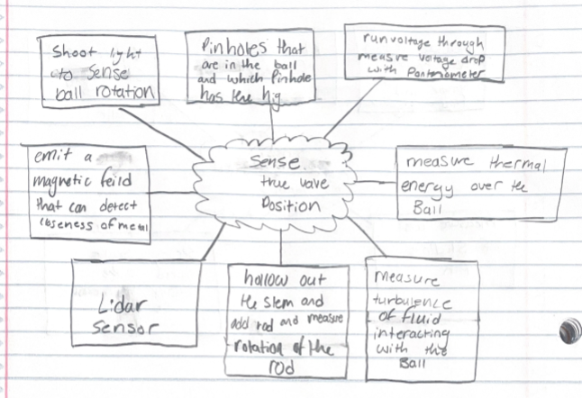
Concept Generation 1
Valve position problem

Slide 8
Concept Generation 2
TRIZ/Generalized Engineering Parameters
Main Parameters to keep in mind -
8: Volume of stationary object
12: Strength
20: Energy consumed by stationary object
27: Reliability
28: Accuracy of measurement
33: User friendliness

Slide 9
Concept Generation 3
Design by Analogy - Focus on true valve position
Used a thesaurus to generate synonyms for the deliverable then looked for applications of new terms in other fields.
Synonyms for position:
Location
Orientation
Rotation

Slide 10
Concept Generation 3
Determining location concepts by using ideas in other fields
Echolocation: Bounce sound waves off the metal ball then collect data to determine the location of the valve
Radar: Detect the location of objects underwater. Can be used for the valve by bouncing electromagnetic waves off the ball of the valve and using that data to determine position.
Dams: Attach a flow meter to the orifice of the ball valve and calibrating the sensor will allow for the flow rate to indicate how far the ball has been turned.

Slide 11
Concept Generation 3
Determining orientation concepts by using ideas in other fields
Compass: Utilize magnetic fields to find the orientation of the ball. Would need a hypersensitive compass and magnetize the ball of the valve.
Mosquito: Use heat to orientate them towards fresh blood. Can non uniformly heat the ball of the valve then use thermocouples to collect the heat at a certain area. And depending on the temperature reading will give position.

Slide 12
Concept generation 3
Determining rotation concepts by using ideas in other fields
Car wheel suspension: Attach a spring to the ball inside of a hollowed out stem. Rotating the ball will apply a force to the spring and can use that force and calibrate it to find position.
Sinks: handle is turned to set pressure of water. Measure the pressure of both sides the pressure difference can indicate the position of the valve.

Slide 13
Concept Generation 4
Morphological Analysis
Input Electricity | Measure Torque | Read Position | Embed System | Transmit data
Outlet Power | Torque Bracket | Potentiometer | Casing for Valve | Ethernet
Battery Powered | Rotational Torque Sensor | Hall Effect Probe | Independent Casing | Internet
Solar/ Renewably powered | Washer Strain Gages | Flow meters | Casing for actuator | Light Indicator
 | Force Sensors | Magnetic Fields |  | Sound Indicator
Concept: Embed a rotational torque sensor and potentiometer within actuator casing. When the actuator is toggled, the rotational torque sensor measures the applied force. A calibrated potentiometer applied to the ball of the valve detects the exact change in potential of the system as the stem rotates, and determines the true position.

Slide 14
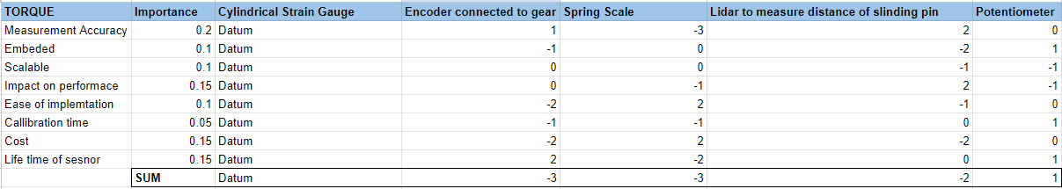
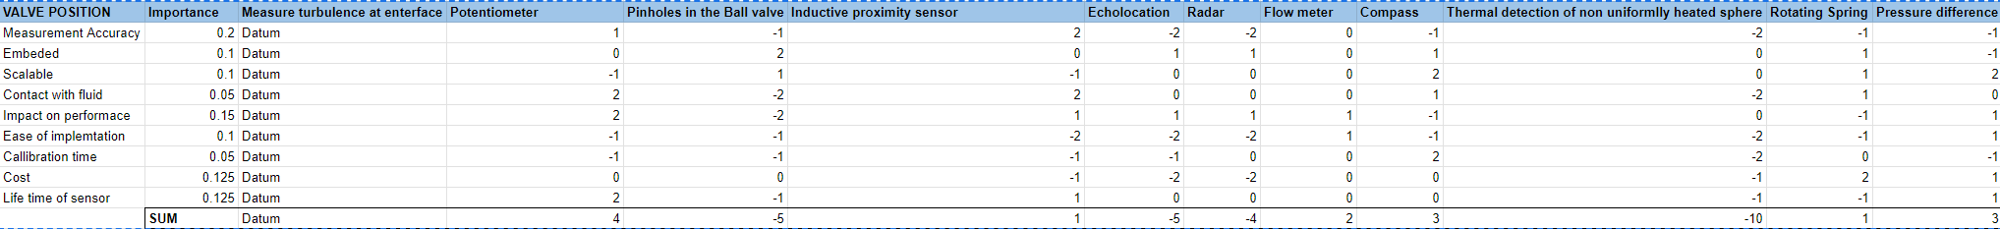
Pugh Charts

Slide 15
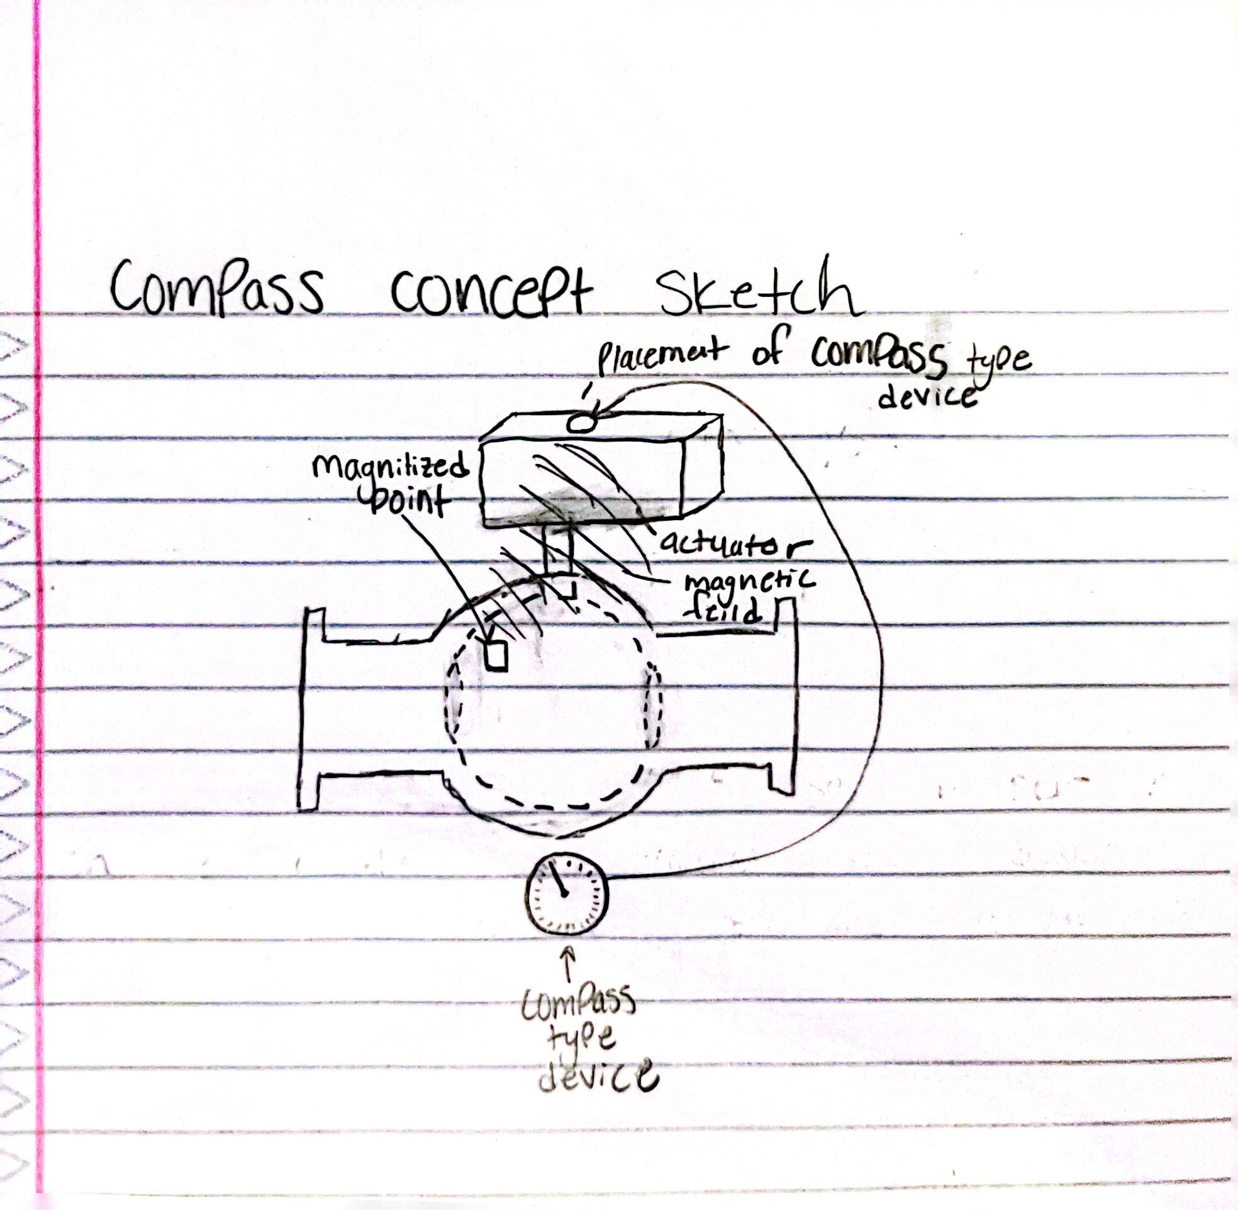
Concept Possibility 1: Position
Compass-style indicator
Would need to magnetize the ball of the valve
Could be visual indicator, digital screen that detects movement of the magnetic field
Will alter properties of the valve so might affect valve performance

Slide 16
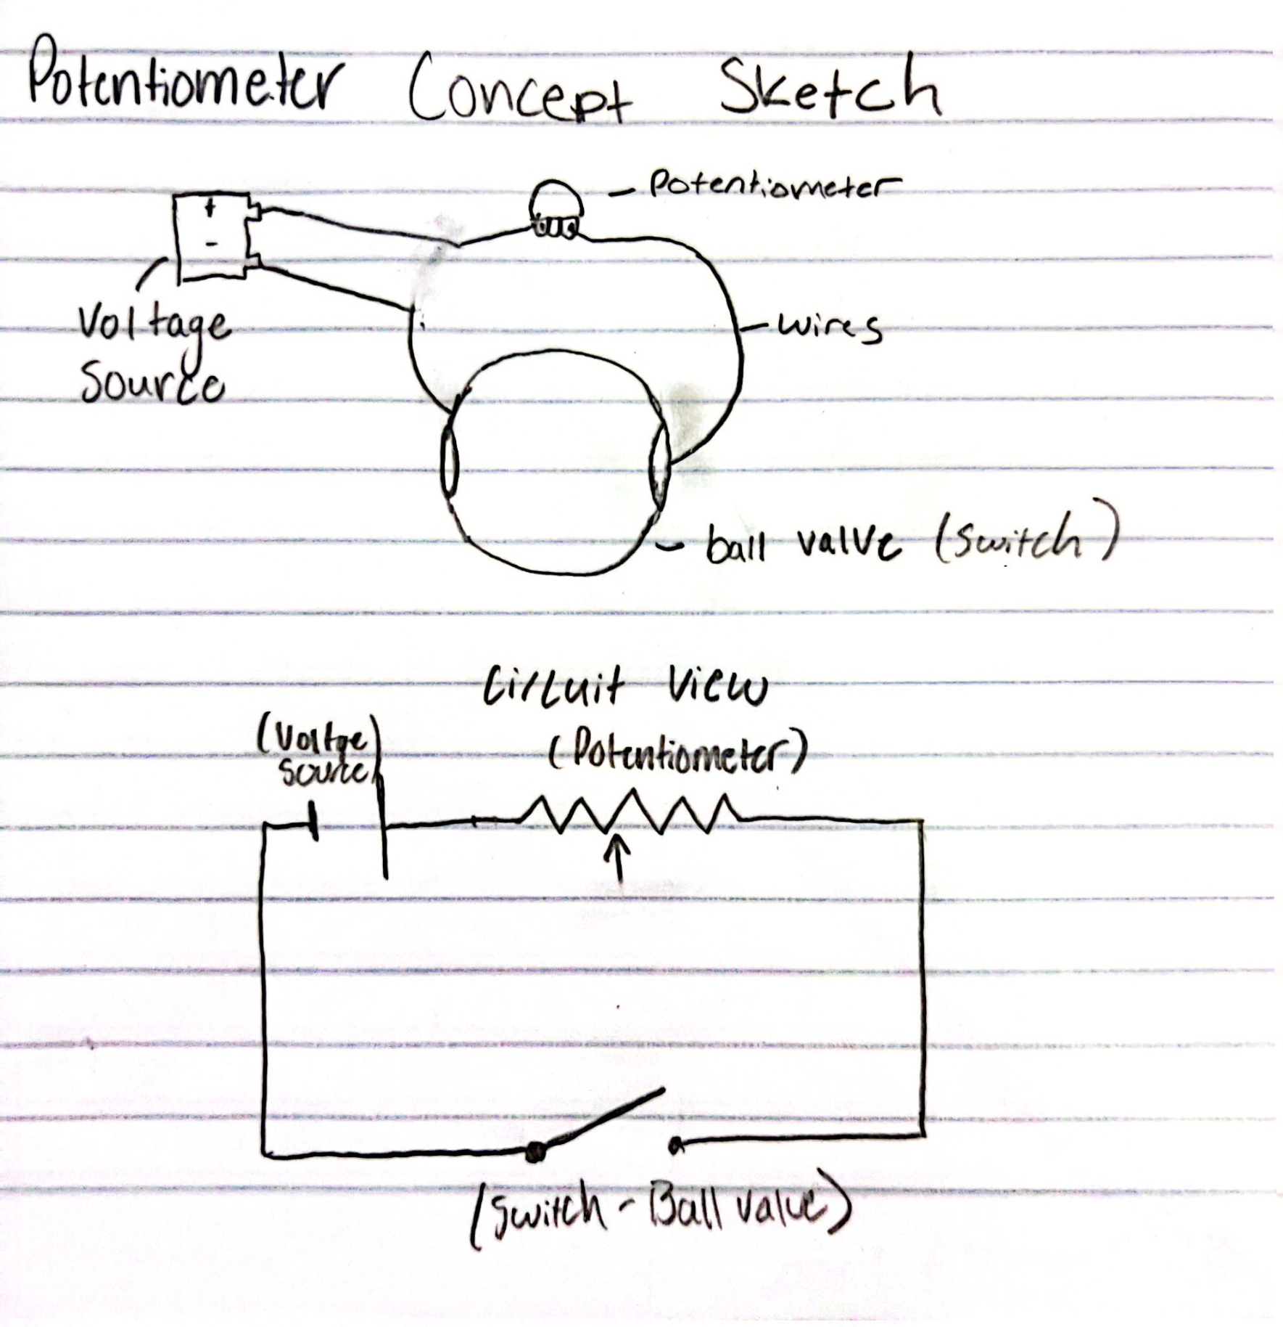
Concept Possibility 2: Position
Embedded potentiometer-
Located on the ball or adjacent casing
Able to measure changes voltage as ball is moved, then converts into position data
Possible locations could be rim of bore or below ball

Slide 17
Torque deliverable

Slide 18
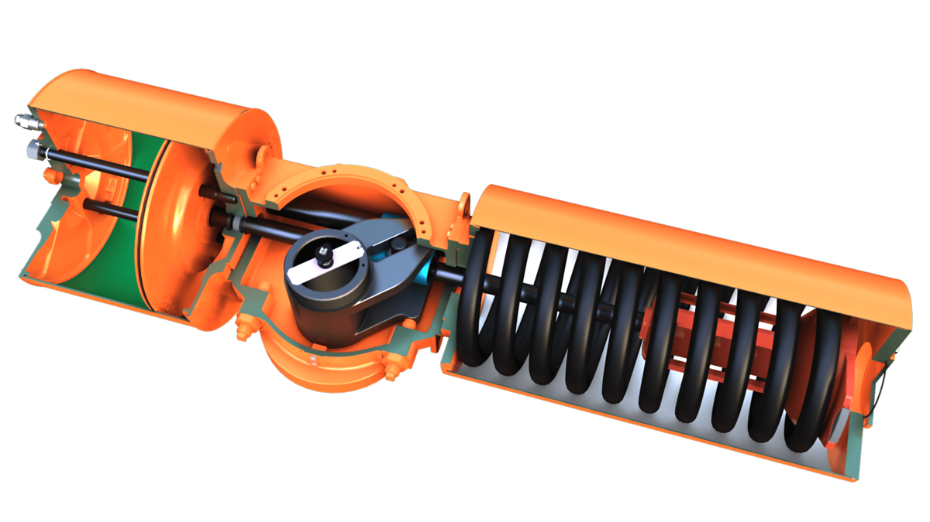
Concept Possibility 3: Torque
Cylindrical Strain gauge at Scotch-Yoke Actuator Stops
Two Force Sensors at the Actuator stop pads
When actuator is toggled, the mechanism moves from one stop to the other, applying a force to the force sensor
Knowing Torque = Force * radius, determine the instantaneous torque applied by actuator
Assumes constant torque is applied

Slide 19
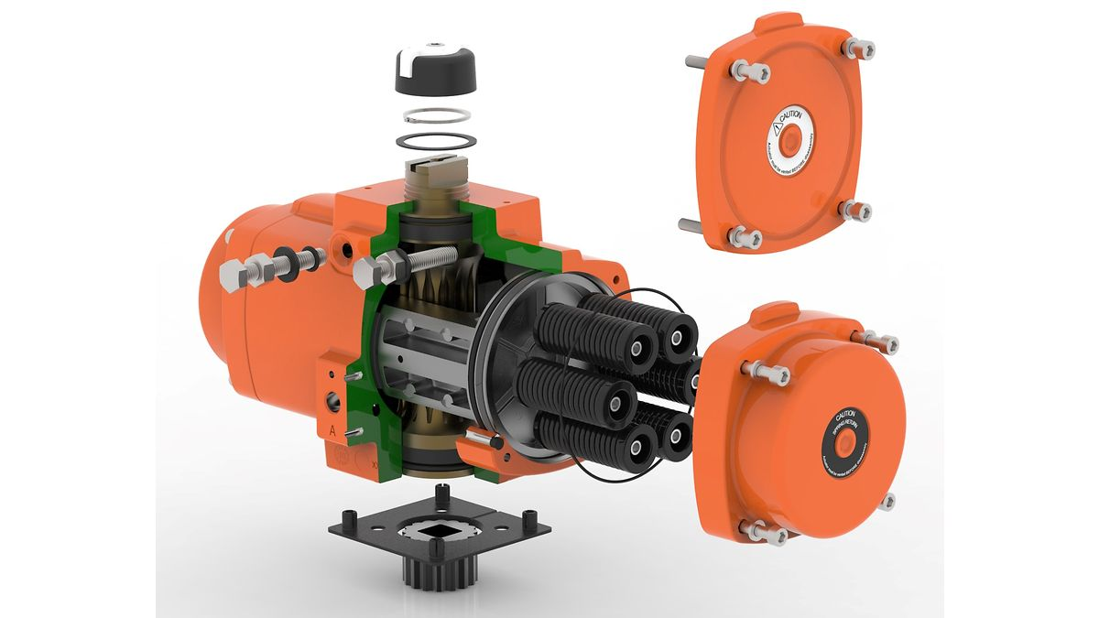
Concept Possibility 4: Torque
Potentiometer at the actuator shaft
Potentiometer applied to the rotating actuator
When actuator is toggled, the mechanism rotates, measuring the difference in potential in the sensor as it moves
Knowing Torque = Moment of Inertia * angular acceleration, determine the continuous torque applied by actuator
Return the average value of the torque
Assume shaft diameter is known

Slide 20
DR2 Progress
Gave all concepts to Bray
Gave Pugh chart concept selection to Bray to review the ratings of each idea
Review technical feasibility of selected 4 concepts with the Bray team
Worked on getting content for the report but havent started writing the report yet

